Slide 1
Corporate Profile
www.metroapi.com

Slide 2
Leading from the front
Dr. N. V. Rao has started Metrochem in the year 2004 with a mission of building a sustainable bulk drug business that would bridge the gap between quality and affordability in this segment. With 30 years of R&D and manufacturing experience, Dr. Rao focused on cultivating a culture of innovation in the organization.
His efforts helped Metrochem grow from a single unit API company to 7 units, 300+ products company in a span of 20 years. Under his leadership, Metrochem has been awarded the “Best Supply Partner” by DRL and was most recently listed as the leading mid corporates in India by Dun & Bradstreet in 2020.
Dr. N. V. Rao
Chairman & Managing Director
PhD in Organic Chemistry

Slide 3
Accessible Management Team
Mr. Harsha Nandepu heads the commercials operations at Metrochem. He has a Master’s in Chemical Engineering from University of Southern California and an MBA from University of Washington. Prior to assuming the current role, Harsha has 6 years of experience at Baxter Bioscience and Mylan, USA at various capacities in the quality assurance and compliance space.
Harsha Vardhan Nandepu
Chief Operating Officer
Mr. Hardev, our Chief Strategy Officer, heads our research and development activities. He has a Master’s in Chemical Engineering from IIT Madras and an MBA from University of North Carolina. Prior to assuming the current role, Hardev has 5 years of experience at Metrochem, as Process Development Head and 1 year as a Marketing Manager at OMIC Seattle.
Hardev Nandepu
Chief Strategy Officer

Slide 4
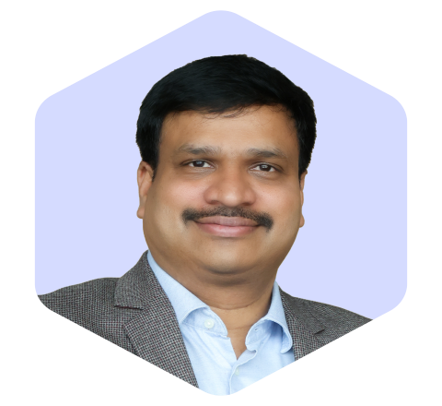
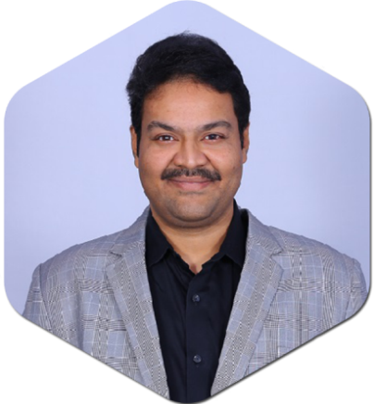
Customer Focused Commercial Team
Pavan Kumar N.
Vice President
Business Development – Regulatory Markets
Chandramani Panda
Chief Financial Officer
Anand Sharad Gharat
Vice President
Marketing – India Market
Arun Kumar K.S.
Vice President
Supply Chain Management
Rajesh Karicherla
Associate Vice President
Human Resource

Slide 5
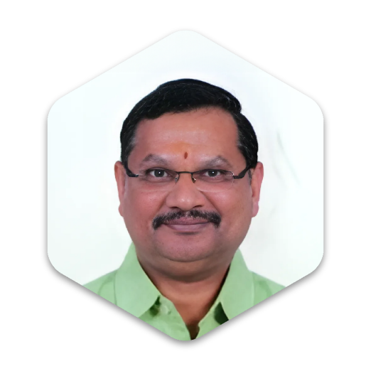
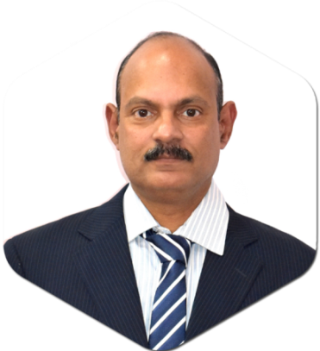
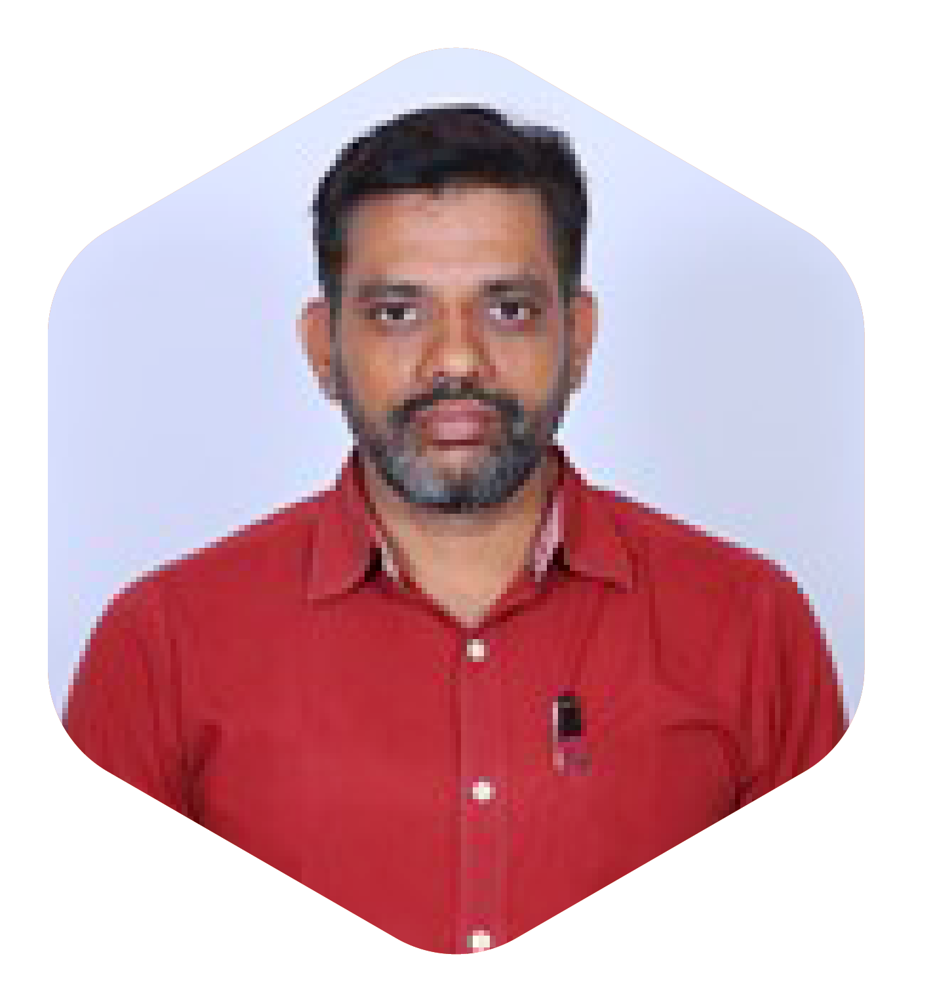
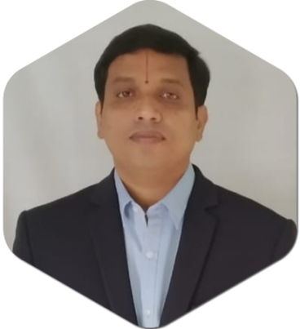
Core Technical Team
Dr. Narender Rao S.
Vice President – R&D
Srinivaas Jonnadula
Associate Vice President - Operations
Rambabu Dunnala
Associate Vice President - Operations
Srinivasa Rao Pulagam
GM - Corporate Quality Assurance
Gopala Krishna Thota
GM – RA & DQA
M. Satya Sundara Srinivas
Vice President - R&D - I
Satyanarayana Bathina
DGM - R&D
Srinivasan Sundararajan
AGM – Intellectual Property

Slide 6
Company Overview
Metrochem is a pure-play, vertically integrated manufacturer of APIs across diverse therapeutic areas. Helmed by 30+ years of research and manufacturing expertise of Dr. N. V. Rao, Metrochem has grown at an exceptional pace since its inception in 2004 and established itself as a leading API manufacturer on a global scale.
Metrochem handles an extremely wide array of products that require specialized skills in handling complex chemistry, developing robust scalable processes, and safe handling of challenging reactions and chemicals, at both grams to multi ton scale. Our six (6) manufacturing facilities confirm to the stringent quality and GMP requirements of several reputed global health authorities such as FDA, PMDA, WHO, COFEPRIS

Slide 7
Vision Mission Values
Our Mission
At Metrochem,
To ensure Operational Excellence, excellent Customer Service on time, Operate in a Safe & Environment-friendly Atmosphere, conduct business with Integrity, and ensure employees are well trained, motivated and satisfied.
we believe that we have a role to play in enriching lives through increased access to affordable healthcare.
Our Vision
Our vision is to become the most
preferred supply partner to our customers worldwide. We aim to achieve sustained growth through consistent delivery of innovative, customer-centric, world-class products. To be a World Class, Research-driven, Vertically Integrated Manufacturer of APIs.
Our Values
LEADER
Learning Aspiration, Excellence,
Action Oriented, Discipline,
Ethics and Integrity, Respect

Slide 8
Our Employees are our Best Assets
350+ Scientists
300+ QA/QC
3500+ Employees
Our workforce gives us the competitive advantage.
We recruit highest quality talent. Our employee accomplishments speak for themselves.
We engage in skill development
Our employees make sure they always surpass the industry expectations

Slide 9
Why Metrochem? Core Competencies
Quality Compliance & Commitment
Gram to Multi Ton Commercialization
R&D – New Products & Patents
Regulatory Expertise – DMFs & CEPs
End to End commercialization
Vertically Integrated Value Chain
Highly Skilled Workforce

Slide 10
Metrochem Roadmap from 2004
Our Journey began with 1 API facility, manufacturing 2 APIs
Scale Up
Construction of our 10 acre Greenfield Vizag API plant initiated
Forward Integration
Started our Pellet facility
2009
2013
KFDA for API facility
2016
2005
Backward Integration
Started our Intermediate facility
2014
2004
2006
PMDA Approval For API Facility
2012
WHO-GMP, USFDA and COFEPRIS approval for API facility
Metrochem joins $100M club
Leading Mid Corporates of India – Dun & Bradstreet
2017
2018
2019
2021
2022
2024
2023
Production commences at Vizag plant
750KL reactor volume
Metrochem Revenue $108M
“Best Bulk Drug Company in India” – Department of Pharma
USFDA, ANVISA approval
Best supply partner award from
Dr. Reddy’s
#1 USDMF filings
across the globe
$150M revenue
“Overall Excellence” award from Govt of Telangana
PMDA Approval for Unit-IV Facility
FDA approval with zero 483s, PMDA

Slide 11
Our Numbers at a Glance
Market Leader in Antiulceratives (PPI) therapeutic category
Manufacturing Facilities
FY 2022-23
Revenue
Team of
R&D Scientists
Reactor Volumes
Countries Served
6
$150
Mn
#1
350+
3000
KL+
60+
6000+
200+
2
3500+
350+
Tons of API Annual Production
Products in high growth therapeutic categories
Number of
R&D Facilities
Our current workforce
Number of reactors ranging from 5L to 15KL

Slide 12
Consistent Growth in our Revenues year on year

Slide 13
Spearheading DMF and CEP filings
Product Name | USDMF No.
Oxiconazole Nitrate IHS | 34173
Antazoline Phosphate USP | 34330
Clopidogrel Bisulfate USP | 34334
Etoricoxib IHS | 34537
Silodosin IHS | 34538
Dexketoprofen Trometamol IHS | 34732
Levocetirizine Dihydrochloride USP | 34731
Omeprazole USP | 34759
Lurasidone Hydrochloride IHS | 34756
Prucalopride Succinate IHS | 34970
Vonoprazan Fumarate | 35150
Dexlansoprazole IHS | 34971
Empagliflozin | 35345
Omeprazole Magnesium USP | 35390
Rabeprazole Sodium | 35344
Esomeprazole Magnesium Trihydrate USP | 35400
Lansoprazole USP | 35485
Ozenoxacin | 35487
Esomeprazole Magnesium Dihydrate USP | 35519
Apixaban | 35518
Posaconazole | 35517
Febuxostat | 35578
67+ US
DMFs
500+ Registrations
22+
CEPs

Slide 14
Spearheading DMF and CEP filings
Product Name | USDMF No.
Tedizolid Phosphate | 35515
Pantoprazole Magnesium | 35516
Febuxostat (Form-A) USP | 35797
Teneligliptin Hydrobromide Hydrate | 35576
Pantoprazole Sodium USP | 35577
Tofacitinib Citrate | 35976
Dapagliflozin Propanediol Monohydrate | 36048
Bempedoic Acid | 36085
Imeglimin Hydrochloride | 36107
Silodosin beta form | 36132
Loxoprofen Sodium Hydrate | 36114
Dapagliflozin (Amorphous) | 36608
Zinc Chloride USP | 36964
Zinc Sulfate Heptahydrate USP | 36963
Mirabegron | 36973
Bilastine | 36965
Alogliptin Benzoate | 37908
Chromic Chloride Hexahydrate USP | 36959
Cupric Chloride Dihydrate USP | 36961
Cupric Sulfate Pentahydrate USP | 36962
Dabigatran Etexilate Mesylate | 37633
67+ US
DMFs
500+ Registrations
22+
CEPs

Slide 15
Spearheading DMF and CEP filings
Product Name | USDMF No.
Edoxaban Tosylate Monohydrate | 37896
Elobixibat | 37340
Fosravuconazole L-Lysine Ethanolate | 37342
Isavuconazonium Sulfate | 36974
Manganese Sulfate Monohydrate USP | 36960
Migalastat Hydrochloride | 37632
Posaconazole Form – I | 36969
Rabeprazole Sodium Form – Y | 37630
Ranolazine | 37339
Selenious Acid USP | 36958
Stiripentol | 38097
Vigabatrin | 38089
Lacosamide | 38789
Pantoprazole Magnesium (PAM) | 38995
Tofacitinib Citrate (PAI) | 38994
Dexlansoprazole (DXJ) | 38997
L-Glutamine | 38992
Tegoprazan | 38991
Levocarnitine USP | 38993
Dexlansoprazole Anhydrous | 39595
Isavuconazonium Sulfate (KYO) | 39823
Upadacitinib Hemihydrate | 39979
Nicardipine Hydrochloride | 40235
67+ US
DMFs
500+ Registrations
22+
CEPs

Slide 16
Spearheading DMFs and CEP filings
Product Name | CEP No. | Date of Submission
Antazoline Hydrochloride EP | CEP 2020-060 | 10-Feb-2020
Clopidogrel Hydrogen Sulfate EP | CEP 2020-093 | 13-Mar-2020
Omeprazole EP | CEP 2020-182 | 08-Jun-2020
Esomeprazole Sodium EP | CEP 2020-214 | 30-Jun-2020
Omeprazole Sodium EP | CEP 2020-372 | 10-Nov-2020
Omeprazole Magnesium EP | CEP 2020-380 | 12-Nov-2020
Esomeprazole Magnesium Trihydrate EP | CEP 2020-386 | 21-Nov-2020
Rabeprazole Sodium Hydrate EP | CEP 2020-387 | 21-Nov-2020
Lansoprazole | CEP 2021-009 | 25-Dec-2020
Esomeprazole Magnesium Dihydrate EP | CEP 2021-022 | 28-Dec-2020
Dimetindene Maleate EP | CEP 2021-080 | 06-Feb-2021
Pantoprazole Sodium Sesquihydrate | CEP2021-168 | 31-Mar-2021
67+ US
DMFs
500+ Registrations
22+
CEPs

Slide 17
Spearheading DMF and CEP filings
67+US
DMFs
Product Name | CEP No. | Date of Submission
Zinc Sulfate Heptahydrate | CEP 2022-422 | 18-Oct-2022
Rabeprazole Sodium Hydrate (RBL process) | CEP 2022-429 | 21-Oct-2022
Zinc Chloride | CEP 2022-426 | 21-Oct-2022
Copper Sulfate Pentahydrate | CEP 2022-438 | 29-Oct-2022
Manganese Sulfate Monohydrate Ph. Eur. | CEP 2022-464 | 17-Nov-2022
Rabeprazole Sodium Hydrate (Y Form) | CEP 2022-468 | 19-Nov-2022
Pantoprazole Sodium Sesquihydrate (PAS Process) | CEP 2023-127 | 30-03-2023
Vigabatrin | CEP 2023-279 | 26-07-2023
Lacosamide | CEP 2023-365 | 29-09-2023
Dabigatran Etexilate Mesylate | CEP 2024-13 | 29-02-2024
500+ Registrations
22+
CEPs

Slide 18
Regulatory Forecast for the next 5 Years
$500
Million+
175+
USDMFs
1500+ Registrations

Slide 19
Regulatory Progress of Metrochem
Our Unit-IV Vizag API Facility has been granted USFDA & PMDA approvals.

Slide 20
Name of Regulatory Authority | Approved on | Manufacturing Site
COFEPRIS | Dec-2012 | Unit - I
USFDA | Mar-2013 | Unit - I
MFDS | Feb-2014 | Unit - I
USFDA | Feb-2016 | Unit - I
USFDA | May-2019 | Unit - C
PMDA | May-2019 | Unit - I
WHO GMP | Aug-2020 | Unit - IV
ISO (EMS & OHS) | Jan-2022 | Unit - IV
PMDA | Aug-2023 | Unit - IV
USFDA EIR | Jan-2024 | Unit - IV
ANVISA | July-2024 | Unit - IV
MFDS | Sep-2024 | Unit - IV
TGA | On or before December, 2024 | Unit - IV
Regulatory Progress over Years

Slide 21
Regulatory Compliance
USFDA
EDQM EUROPE
PMDA JAPAN
COFEPRIS MEXICO
MFDS KOREA
TGA Australia
WHO-GMP
ISO 9000:2015

Slide 22
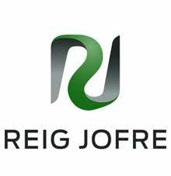
Some of Key Business Partners
A Strong client base of 500+ Active Customers

Slide 23
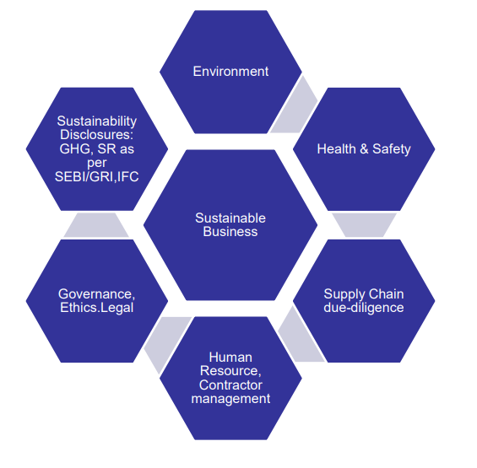
Environmental, Social and Governance (ESG) Framework at Metrochem

Slide 24
Our ESG Roadmap for the Future
Our Ambition |  | Target 2027 | Target 2035
Environment | Carbon Neutrality | 10% of renewable energy share (Power to Power) | 25% of renewable energy share (Power to Power)
 |  | Reduce energy consumption by 15% | Reduce energy consumption by 30%
 |  | Reduce carbon emissions by 15% | Reduce in Carbon emissions by 20%
 |  |  | Net Zero mission of the industry
 | Water Stewardship | Water usage reduction by 7% | Water usage reduction by 20%
 |  | Increase water reuse/recycle by 25%
 |  |  | Increase water reuse/recycle by 50%
 | Waste Minimization | Reduce waste generation by 15% | Reduce waste generation by 30%
 |  | 50% Coprocessing of Hazardous Waste | 100% Coprocessing of Hazardous Waste
 |  | 100% reuse and recycle /reuse of non-hazardous waste | Zero waste to landfill by year 2030
Social | Women Empowerment | 10% Women employment out of total | Women Empowerment - 30% Women employment out of total
 | Training & Development | 30 hours of training per employee/year | Training & Development - 50 hours of training per employee/year
 | Zero Accident/Zero harm | Zero Accident / Zero Harm | Zero Accident / Zero Harm
Governance | IT Policies | Zero incidents on data breach / loss of data | Zero incidents on data breach / loss of data
 | Ethics | 45% employees trained on company ethics, human rights, working conditions, anti-corruption policies and procedures | 100% employees trained on company ethics, human rights, working conditions, anti-corruption policies and procedures
Supply Chain Sustainability | Supply Chain Sustainability | Develop supplier code of conduct and 100% of suppliers assessed on suppliers code of conduct | 100% supply chain due-diligence
 |  | 30% Supplier capacity building though workshops / seminars or training programmes | Reduce water, waste and energy by 30% per unit of product/services delivered

Slide 25
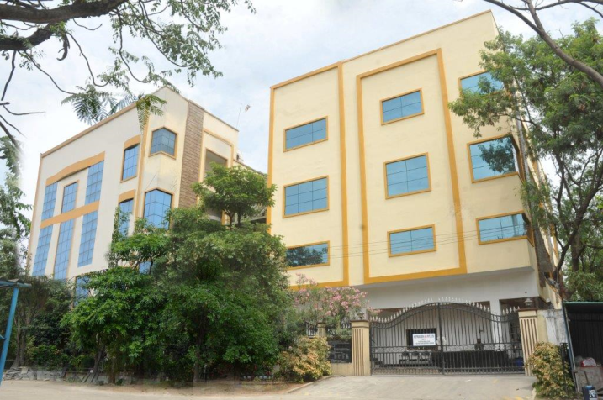
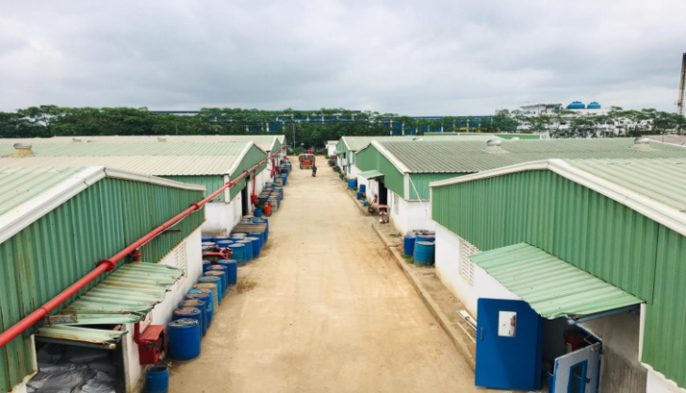
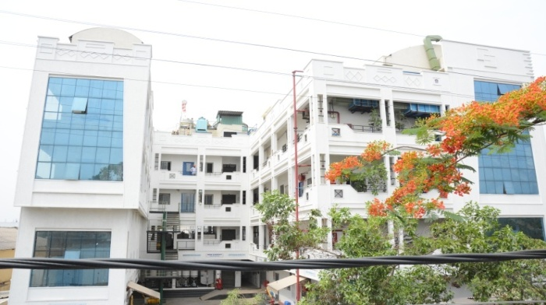
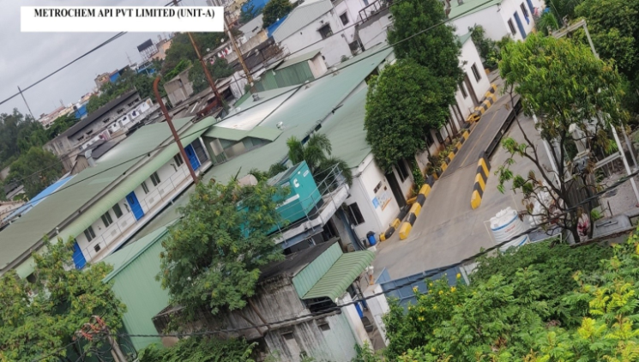
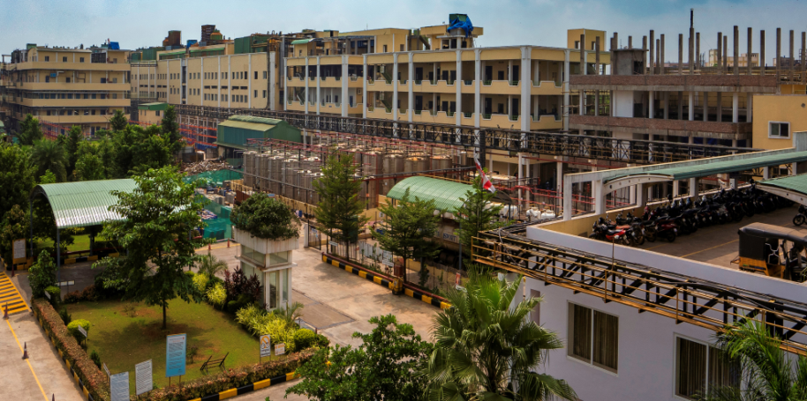
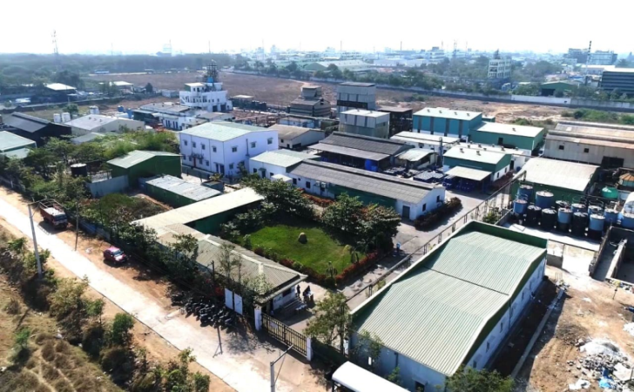
State of the art Manufacturing Facilities
Unit I
Unit II
Unit B
IDA, Jeedimetla, Hyderabad
[30Kms from Air Port]
Jeedimetla Industrial Area, Hyderabad
[30Kms from Air Port]
Bonthapally, Hyderabad
[68 Kms from Air Port]
Unit A
Unit IV
Unit C
IDA, Jeedimetla, Hyderabad
[30Kms from Air Port]
Paravada, Vizag
[30Kms from Air Port]
Kazipally, Hyderabad
[64 Kms from Air Port]

Slide 26
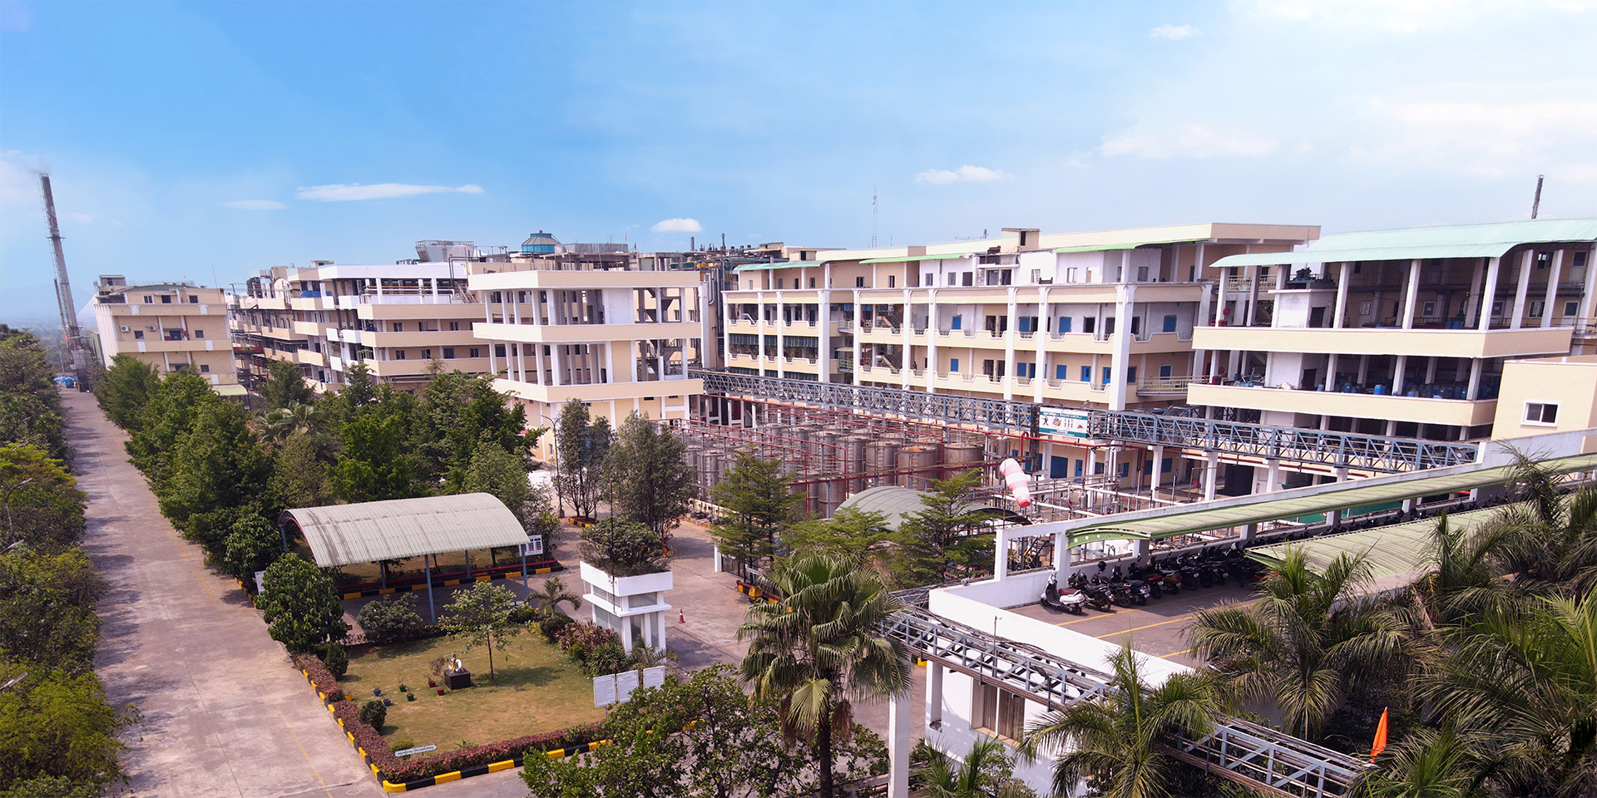
Unit IV API Multi-Product Facility
We have procured 10 Acres of land opposite this site for future expansions

Slide 27
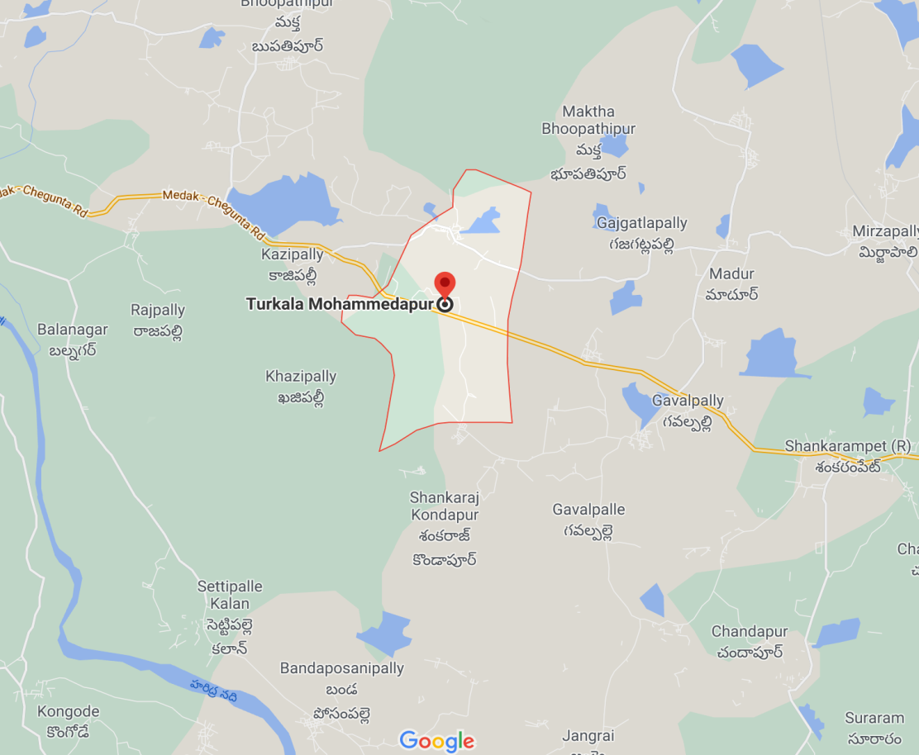
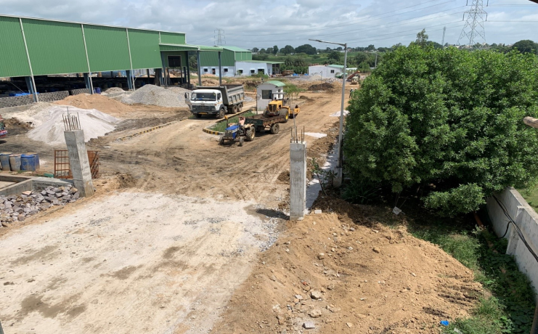
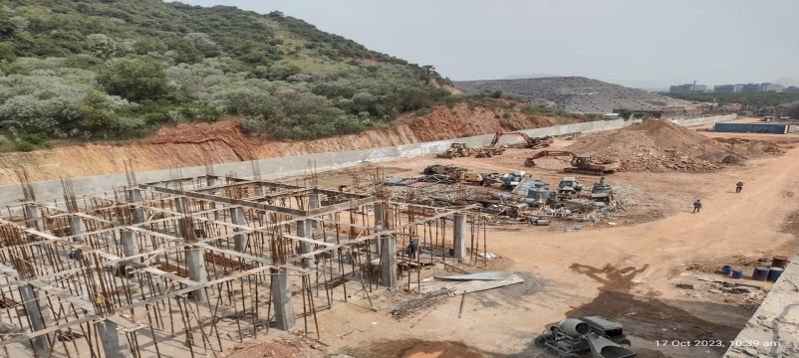
Future CAPEX Planning
In line with our business plan, areas for future CAPEX were mapped out, and construction work has commenced at Unit B and Unit V. Altogether, around 100Acres of Pharma area is available for future CAPEX in addition to the existing sites.
Unit B – Intermediates, 15 Acres
Bonthapally, Hyderabad [68 Kms from Air Port]
Unit V - API, 10 Acres
Paravada, Vizag [30Kms from Air Port]
57Acres land secured for Greenfield project in Shankarpally, Hyderabad

Slide 28
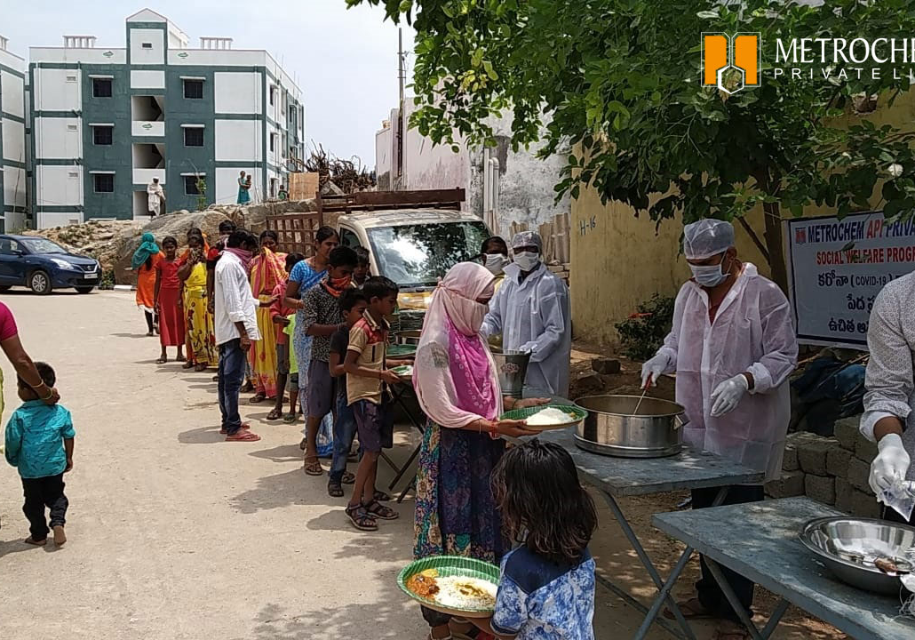
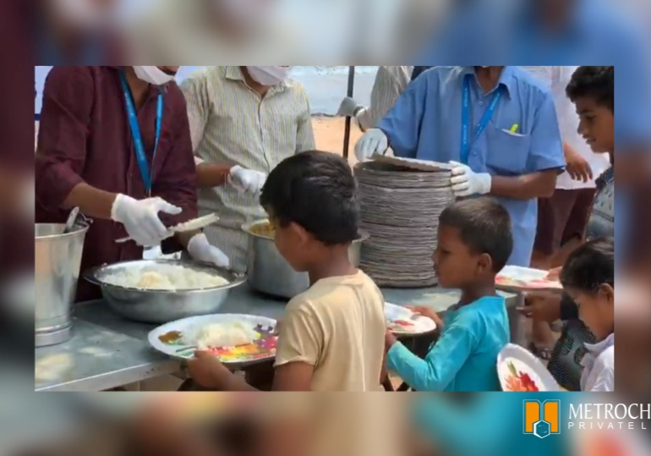
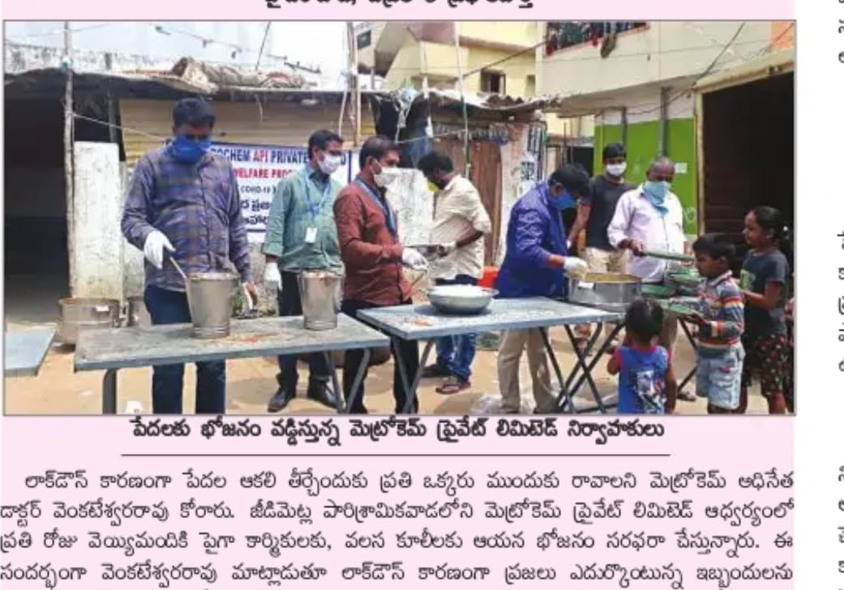
Corporate Social Responsibility
We understand our social responsibility towards the upliftment of the underserved and less privileged communities

Slide 29
India Pharma - Bulk Drug Company of the Year 2021

Slide 30
60+ Countries Served
We deliver customized Volume and Quality APIs Globally
Serving 60+ Countries…

Slide 31
Thank you
040- 69069999
facebook.com/MetrochemAPIPvtLtd/
www.metrochem.com
twitter.com/MetrochemAPI
contact@metroapi.com

